Slide 1
Pancreatic exocrine insufficiency and pancreatic enzyme replacement therapy Mary Phillips BSc (Hons) RD DipADP Advanced Specialist Dietitian (Hepato-pancreatico-biliary surgery) Royal Surrey County Hospital, UK Post Graduate Researcher, University of Surrey, UK

Slide 2
Introduction: setting the scene

Slide 3
Introduction
Anatomy and function of the pancreas
Causes and incidence of pancreatic exocrine insufficiency
Impact of pancreatic exocrine insufficiency
Managing pancreatic enzyme replacement therapy
Recommendations for practice

Slide 4
Poll
What is PEI?
When the pancreas stops digesting fat
When the pancreas stops making insulin
When the pancreas is withered / atrophic
When the pancreas stops making enough enzymes

Slide 5
Definition
“...deficiency or absence of digestive enzymes leading to maldigestion of food and consequently malabsorption of nutrients” (Whitcomb et al, 2010)
“....pancreas is unable to deliver sufficient amounts of digestive enzymes to the small intestine, leading to maldigestion” (Sikkens et al, 2012)
“Exocrine pancreatic insufficiency results from a progressive loss of acinar pancreatic cells which leads to the secretion of an insufficient amount of digestive enzyme into the duodenum.” (Pezzilli et al, 2013)
Failure of the pancreas to secrete sufficient enzymes to achieve normal digestion
Notes:
Whitcomb DC, Lehman GA, Vasileva G, Malecka-Panas E, Gubergrits N, Shen Y, et al. Pancrelipase delayed-release capsules (CREON) for exocrine pancreatic insufficiency due to chronic pancreatitis or pancreatic surgery: A double-blind randomized trial. The American journal of gastroenterology. 2010;105(10):2276-86.
Pezzilli R, Andriulli A, Bassi C, Balzano G, Cantore M, Delle Fave G, et al. Exocrine pancreatic insufficiency in adults: a shared position statement of the Italian Association for the Study of the Pancreas. World journal of gastroenterology : WJG. 2013;19(44):7930-46.
Sikkens EC, Cahen DL, van Eijck C, Kuipers EJ, Bruno MJ. Patients with exocrine insufficiency due to chronic pancreatitis are undertreated: a Dutch national survey. Pancreatology : official journal of the International Association of Pancreatology. 2012;12(1):71-3.

Slide 6
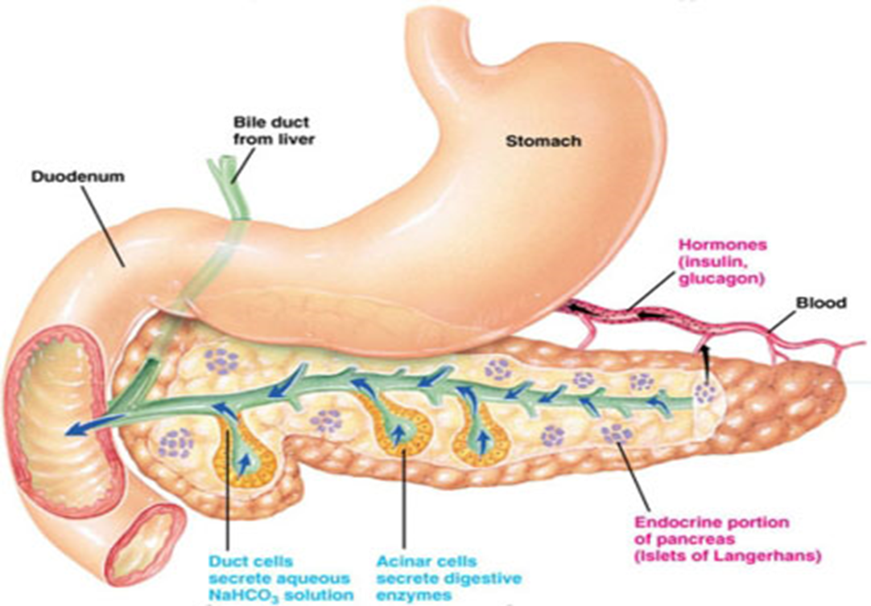
Anatomy and function
Oblong gland 12.5 x 2.5cm
Consists of endocrine cells: islets of langerhans) which produce glucagon, insulin etc (1% of all cells)
99% cells – exocrine function – producing pancreatic enzymes and fluid. (1200-1500mls/day)

Slide 7
Digestive enzymes
Site | Carbohydrate | Fat | Protein
Saliva | Amylase | Salivary lipase
Gastric Secretion | Gastric Amylase | Gastric Lipase | Pepsin; Rennin; Gelatinase;
Pancreatic Secretion | Amylase | Lipase; Steapsin | Trypsin; Elastase; Chymotrypsin; Carboxypeptidase;
Jejunal / Ileal Secretion | Sucrase; Maltase; Lactase Isomaltase; | Intestinal Lipase | Brush Border Peptidases

Slide 8
Anatomy and function of the pancreas
Causes and incidence of pancreatic exocrine insufficiency
Impact of pancreatic exocrine insufficiency
Managing pancreatic enzyme replacement therapy
Recommendations for practice

Slide 9
Causes of PEI
Lack of Healthy Pancreatic Tissue (Primary Insufficiency)
Pancreatic Resection - Chronic Pancreatitis
Recovering Acute Pancreatitis - Pancreatic Cancer
Pancreatic Trauma - Cystic Fibrosis
Lack of Pancreatic Stimulation (Secondary Insufficiency)
Gastric Resection
Duodenal Resection
Some work suggests insufficiency in Coeliac Disease, Diabetes, Irritable bowel syndrome, intensive care, inflammatory bowel disease and the elderly
Layer et al, 2001
Notes:
Layer P, Keller J, Lankisch PG. Pancreatic enzyme replacement therapy. Current gastroenterology reports. 2001;3(2):101-8

Slide 10
Poll
Which of these is NOT correct?
Up to 98% of patients will have PEI after a Whipples
More than 50% of people with pancreatic cancer will have PEI on diagnosis
People with PEI will always have diarrhoea
PEI usually gets worse with time

Slide 11
How common is PEI in pancreatic cancer?
Present in the vast majority of people with pancreatic cancer
Progressive
66-94% of patients have PEI at first presentation (all comers)
Function deteriorates at approximately 10% per month
Function tests can take 2-6 weeks to give results
Incidence after surgery depends on the type of operation
20-80% tail of pancreas (distal pancreatectomy)
Up to 98% head of pancreas (pancreatico-duodenectomy / Whipple)
Sikkens et al, 2014, Tseng et al, 2016, Phillips et al, 2021, Phillips M, 2015, Okano, 2016

Slide 12
Pancreatic Function Tests
Faecal Elastase
<200ug/g moderate PEI
<100ug/g severe PEI
200 – 500ug/g (low sensitivity/specificity)
>500ug/g: Consider age; Dilutional samples (watery / large volume stool); Sample collection technique
Breath tests
Calibre of pancreatic tissue on imaging: Pancreatic ductal dilatation

Slide 13
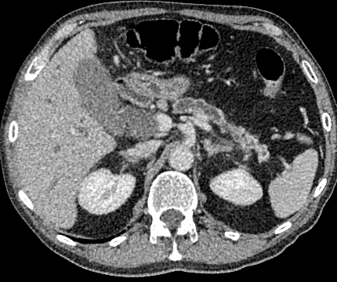

Slide 14
Poll
Which of these is NOT a symptom of PEI?
Bloating
Blood sugars that are lower than usual
Vitamin and mineral deficiencies
Failure to gain weight despite eating really well
New diagnosis of diabetes

Slide 15
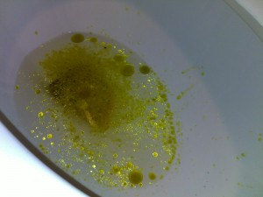
Clinical symptoms (1)
Steatorrhoea
Loose watery yellow/orange stool
Floats / difficult to flush away
Oily / visible food particles
LIMITATIONS
NOT PRESENT in low fat diet
MASKED by constipating drugs
VERY LATE symptom

Slide 16
Clinical symptoms (2)
Large volume stool
Undigested food in the stool
Post-prandial abdominal pain
Nausea / colicky abdominal pain
Gastro-oesophageal reflux symptoms
Bloating / flatulence
Weight loss despite good oral intake
Vitamin deficiencies (especially A,D,E,K,)
Hypoglycaemia in patients with diabetes
(O’Keefe et al, 2001, Genova Diagnostics, 2008, Friess & Michalski, 2009)
Notes:
O'Keefe SJ, Cariem AK, Levy M. The exacerbation of pancreatic endocrine dysfunction by potent pancreatic exocrine supplements in patients with chronic pancreatitis. Journal of clinical gastroenterology. 2001;32(4):319-23.
GenovaDiagnostics. Digestion/Absorption Pancreatic Elastase. CDSA & CDSA 20 Support Guid. 2008
Friess H, Michalski CW. Diagnosing exocrine pancreatic insufficiency after surgery: when and which patients to treat. HPB : the official journal of the International Hepato Pancreato Biliary Association. 2009;11 Suppl 3:7-10.

Slide 17
Diagnosis
Pancreatic pathology
Clinical
symptoms
Likely PEI
Pancreatic pathology
Diagnostic
test
Likely PEI
Consider PEI and investigate for pancreatic pathology
Diagnostic
test
Clinical
symptoms

Slide 18
Anatomy and function of the pancreas
Causes and incidence of pancreatic exocrine insufficiency
Impact of pancreatic exocrine insufficiency
Managing pancreatic enzyme replacement therapy
Recommendations for practice

Slide 19
Malignant disease
Survival
RCT (unresectable ca pancreas)– no benefit; but predominantly tail of pancreas disease (Woo et al, 2016)
Independently associated with survival in unresectable disease (189 vs. 95 days, retrospective) (Dominguez-Munoz et al, 2018)
ESPAC studies show the benefit of completing the full chemotherapy regime – performance status….
Notes:
Gooden HM, White KJ. Pancreatic cancer and supportive care--pancreatic exocrine insufficiency negatively impacts on quality of life. Support Care Cancer. 2013;21(7):1835-41.
Dominguez-Munoz JE, Nieto-Garcia L, Lopez-Diaz J, Larino-Noia J, Abdulkader I, Iglesias-Garcia J. Impact of the treatment of pancreatic exocrine insufficiency on survival of patients with unresectable pancreatic cancer: a retrospective analysis. BMC cancer. 2018;18(1):534
Cloyd JM, Nogueras-Gonzalez GM, Prakash LR, Petzel MQB, Parker NH, Ngo-Huang AT, et al. Anthropometric Changes in Patients with Pancreatic Cancer Undergoing Preoperative Therapy and Pancreatoduodenectomy. Journal of gastrointestinal surgery : official journal of the Society for Surgery of the Alimentary Tract. 2018;22(4):703-12.
Woo SM, Joo J, Kim SY, Park SJ, Han SS, Kim TH, et al. Efficacy of pancreatic exocrine replacement therapy for patients with unresectable pancreatic cancer in a randomized trial. Pancreatology : official journal of the International Association of Pancreatology. 2016;16(6):1099-105

Slide 21
Trial design
Retrospective observational study
PDAC 1998 – 2015
Excluded those with concurrent pancreatitis, PERT prior to diagnosis

Slide 22
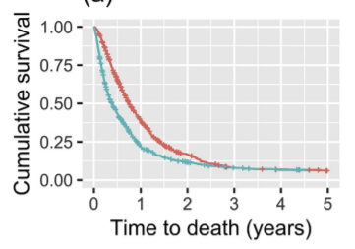
All patients
PERT
Non PERT

Slide 23
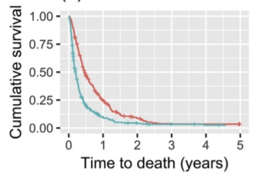
No surgery, no chemo
PERT
Non PERT

Slide 24
Factors influencing survival

Slide 25
<50% patients on PERT

Slide 26
Richocet study (2021)
45% of unresectable patients prescribed PERT
74.4% potentially resectable patients prescribed PERT
96.9% of pancreatic head resection patients prescribed PERT
PERT prescription was more likely if:
Seen by a dietitian (p = 0.001)
Seen in a specialist centre (p= 0.049 – HPB; p=0.009 – pancreas)
Seen by a clinical nurse specialist (p = 0.028)

Slide 27
Implications
37.5 % of readmissions after pancreatic surgery caused by malnutrition and dehydration (Grewal et al, 2011)
Sarcopenia independently associated with PEI (Shintakuya et al, 2017)
“difficulty with digestion” is most common symptom in long term (Cloyd et al, 2017)
PEI guidance primary unmet need in pancreatic cancer (Gooden & White, 2013)
Notes:
Grewal SS, McClaine RJ, Schmulewitz N, Alzahrani MA, Hanseman DJ, Sussman JJ, et al. Factors associated with recidivism following pancreaticoduodenectomy. HPB : the official journal of the International Hepato Pancreato Biliary Association. 2011;13(12):869-75.
Shintakuya R, Uemura K, Murakami Y, Kondo N, Nakagawa N, Urabe K, et al. Sarcopenia is closely associated with pancreatic exocrine insufficiency in patients with pancreatic disease. Pancreatology : official journal of the International Association of Pancreatology. 2017;17(1):70-5

Slide 28
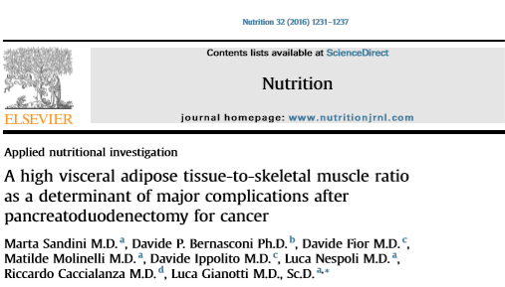
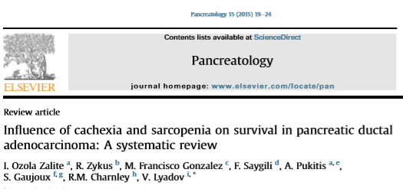
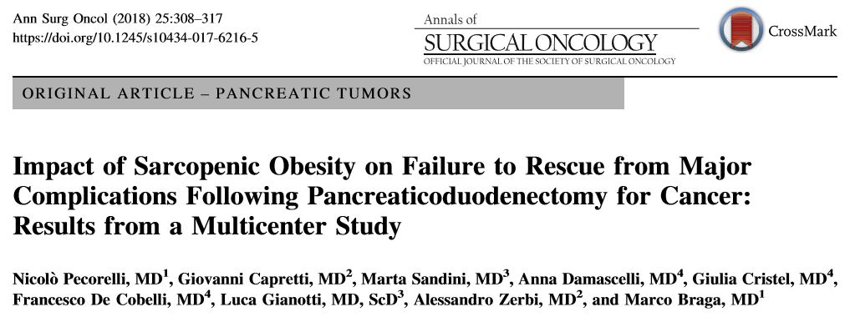
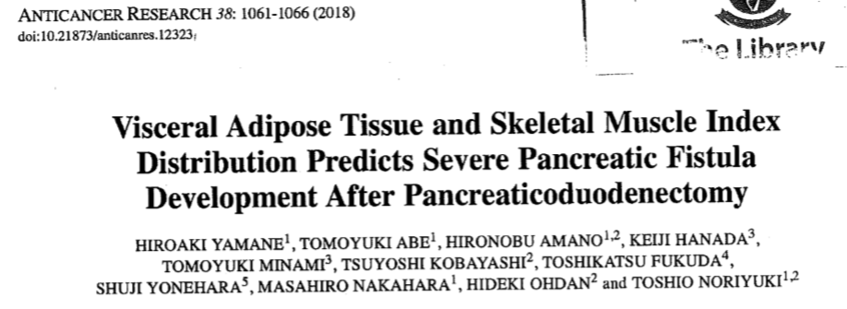
Sarcopenia and outcome…..

Slide 29
Anatomy and function of the pancreas
Causes and incidence of pancreatic exocrine insufficiency
Impact of pancreatic exocrine insufficiency
Managing pancreatic enzyme replacement therapy
Recommendations for practice

Slide 30
UK management
Pancreatic enzyme replacement therapy
Multiple disease aetiology
Co-morbidities
Altered dietary intakes
Altered meal patterns
Healthy eating vs. nutritional support

Slide 31
Poll
What is a suitable starting dose for PERT?
5,000 units with meals
10,000 units with meals
22-25,000 units with meals
44-50,000 units with meals

Slide 32
How do the products compare?
 | Amylase | Protease | Lipase
Creon micro (100mg) | 3600 | 200 | 5000
Pancrex V capsule | 9000 | 460 | 8000
Creon 10,000 | 8000 | 600 | 10000
Nutrizym 22 | 19800 | 1100 | 22000
Creon 25,000 | 18000 | 1000 | 25000
Pancrease HL | 22500 | 1250 | 25000
Pancrex V powder (1g) | 30000 | 1400 | 25000
Creon 40,000 | DISCONTINUED

Slide 33
Dosing
Set dose
Dose per kg
Dose per gram fat
Patient choice
Something else?

Slide 34
Comparison of weight-based doses of enteric-coated microtablet enzyme preparations in patient with cystic fibrosis
N = 21
Population: Cystic Fibrosis
Open label crossover: 500u/kg with meals and 250U/kg with snacks compared to 1500u/kg with meals and 750u/kg with snacks.
Diet : 100g fat / day
CFA: increased from 86% to 91% (P<0.05)
(Beker et al, J.Paed Gastrol Nutr. 1994 Aug;19(2):191-7).
Notes:
(J Pediatr Gastroenterol Nutr. 1994 Aug;19(2):191-7).
Comparison of weight-based dosages of enteric-coated microtablet enzyme preparations in patients with cystic fibrosis.
Beker LT¹, Fink RJ, Shamsa FH, Chaney HR, Kluft J, Evans E, Schidlow DV.

Slide 35
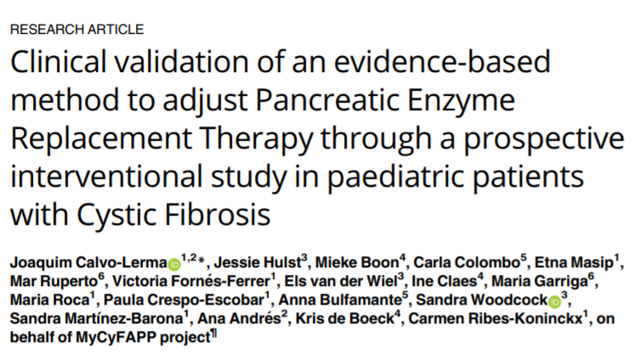

Slide 36
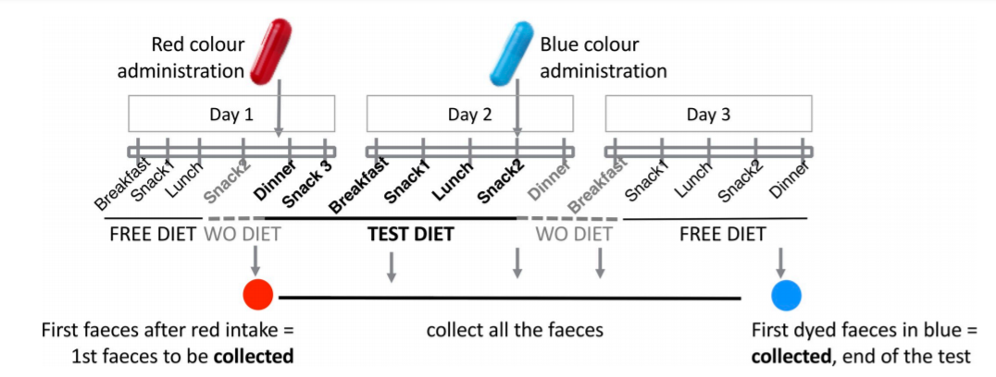

Slide 37
Transit time played a significant role in results: longer the transit time the greater the CFA

Slide 38
And it is not just fat….
4 way Crossover trial: LCT vs. MCT +/- 50,000 units lipase
N= 6, all male Chronic Pancreatitis patients
All had severe exocrine insufficiency (CFA < 80%)
(1 x distal panc, 1 x total gastrectomy, 1 x distal gastrectomy, 1x whipple, 2 on insulin.)
Notes:
Caliari S, Benini L, Sembenini C, Gregori B, Carnielli V, Vantini I. Medium-chain triglyceride absorption in patients with pancreatic insufficiency. Scandinavian journal of gastroenterology. 1996;31(1):90-4.

Slide 39
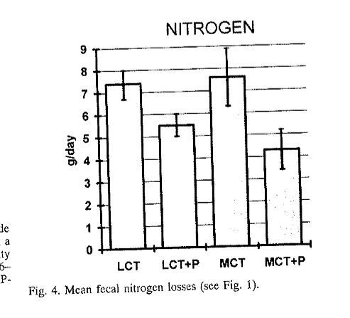
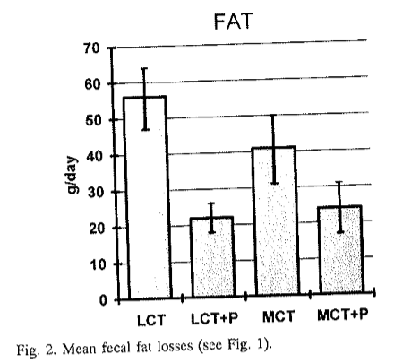
Caliari et al, 1996

Slide 40
Dosing used in clinical trials
Study | Cohort | Dose | Benefit
Kim et al, Clin Gastroenterol Hepatol. 2019 | RCT n=304 Pancreatico-duodenectomy | 40,000 units lipase with meals | Increase body weight; increased pre-albumin
Sato et al, Pancreas. 2018 Aug;47(7):800-806 | N=88 PDAC chemotherapy | 48,000 units lipase with meals | No difference in nutritional markers in 8/52 trial Survival 19/12 vs. 12/12 (p=0.07)
Woo et al, Pancreatology. 2016 Nov - Dec;16(6):1099-1105 | N= 67 Unresectable PDAC | 25,000 capsules x 6-9 per day | NO difference in nutritional markers or QOL in 8/52 trial
Bruno et al, Gut. 1998 Jan;42(1):92-6 | N = 21 Unresectable PDAC | 50,000 units lipase with meals; 25,000 units with snacks | 12% improvement in CFA; weight gain in intervention; weight loss in placebo

Slide 41
Recommended dose
STARTING DOSE....
44 - 50,000 units with meals
22 - 25,000 units with snacks
25 - 50,000 units with supplements
Will need higher dose with larger meals
Increase until symptom control

Slide 42
Poll
Which of these do you NOT need to take PERT with?
Cup of tea and two bourbon biscuits
Mug of peppermint tea
Milkshake
Cup of milky coffee

Slide 43
Anatomy and function of the pancreas
Causes and incidence of pancreatic exocrine insufficiency
Impact of pancreatic exocrine insufficiency
Managing pancreatic enzyme replacement therapy
Recommendations for practice

Slide 45
Recommendations for clinical practice
CONSENT
Timing
Mix with food
Allow for slow meals / multiple courses / gastric emptying
Dose
Minimum starting dose 50,000u with meals; 25,000u with snacks
Increase until symptom control
Snacks vs. meals
Nutritional supplements
Prevent denaturation
<25ºC
?Proton pump inhibitor?
Avoid swallowing with hot food/fluids

Slide 46
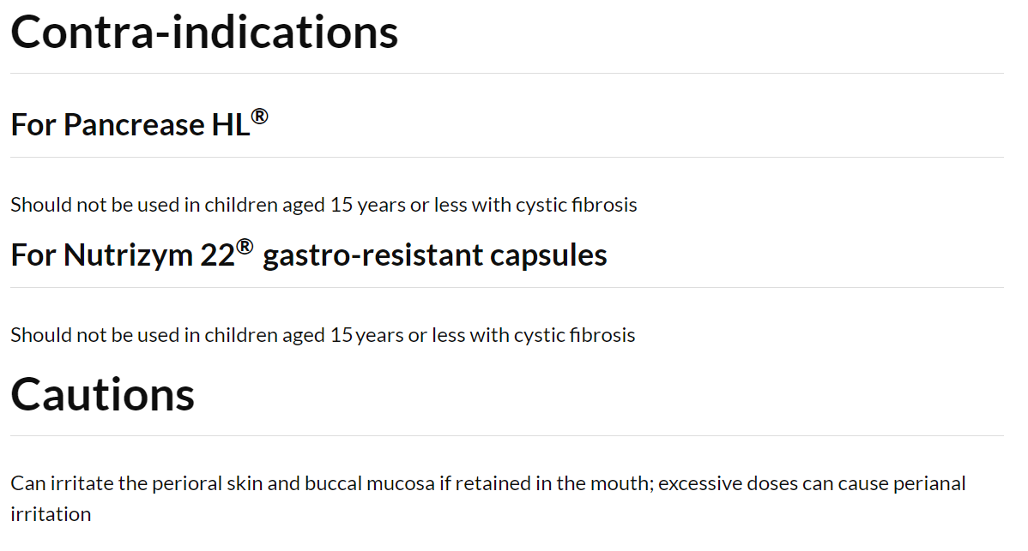

Slide 47
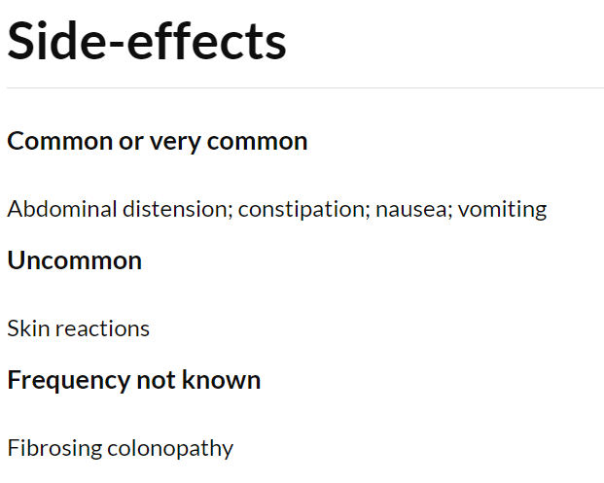

Slide 48
Contraindications and side effects
CONTRAINDICATIONS
CONSENT: Porcine content
Pork allergy / previous intolerance
SIDE EFFECTS
Nausea
Gout (uric acid)
Fibrosing colonopathy
PREGNANCY & BREASTFEEDING:
Essential fatty acids are needed for brain and retinol development in the first 8 weeks of pregnancy – DO NOT STOP PERT
Notes:
Are these different from ours?

Slide 49
What do you NEED to know :PEI
Exocrine insufficiency is progressive and doses escalate with time
Some patients need really high doses (>150,000 units with a meal = >25 capsules / day = 9-10 x 100 cap tubs per month)
Significant pill burden
Micronutrient deficiency common
Enzymes denatured by excess temperature and acid
Treat like insulin – different doses for different patients for different meals

Slide 50
Conclusion
PEI is under recognised
Many patients are on sub-optimal doses
Appropriate therapy improves outcome
Multiple factors play a role in dose adjustment – individual management
Permission to dose escalate
Other conditions can mimic PEI
More data needed to explore relationship with survival in pancreatic cancer.

Slide 51
Case 1

Slide 52
78 year old female
Metastatic pancreatic cancer – liver mets
Declined palliative chemotherapy
Bowels open once a day: type 1 (pellet type stool)
Large volume hard stool
Crampy abdominal pain
5% weight loss each month despite eating well
Functionally well – caring for Grandchildren

Slide 53
Poll
Is this patient at risk / potentially suffering from malabsorption?
Yes – treat
Yes – test and then consider treatment
No
Not sure

Slide 54
Commence laxatives
Once bowel symptoms improved – then start PERT
Biggest symptom was constipation

Slide 55
Case 2
69 year old female
Localised pancreatic ductal adenocarcinoma
Distal pancretectomy and splenectomy – 1cm lesion removed from tail of pancreas
Bowels open 4 x a day loose and watery
Gaining weight, 1-2kg per month
Eating well

Slide 56
Poll
Is this patient at risk / potentially suffering from malabsorption?
Yes – treat
Yes – test and then consider treatment
No
Not sure

Slide 57
Investigate:
Total specimen 2cm tail of pancreas
Head and body of pancreas enhances normally, no duct dilatation
Feacal elastase >500ug/g
Vitamin and mineral levels normal

Slide 58
Poll
Is this patient at risk / potentially suffering from malabsorption?
Yes – treat
Yes – test and then consider treatment
No
Not sure

Slide 59
Outcome
No nutritional compromise
PEI = Failure of the pancreas to secrete enough enzymes to achieve normal digestion
PDAC is a Red Herring
Further investigations – diagnosed small intestinal bacterial overgrowth
Symptoms resolved with antibiotics.

